Slide 1
Come Fly With Me
An insight into aviation traffic within Australia

Slide 3
Data Source

Slide 4
Aviation statistics are published by the Bureau of Infrastructure, Transport, and Regional Economics (BITRE)

Slide 5
Aviation statistics are published by the Bureau of Infrastructure, Transport, and Regional Economics (BITRE)
International & domestic activity are both available

Slide 6
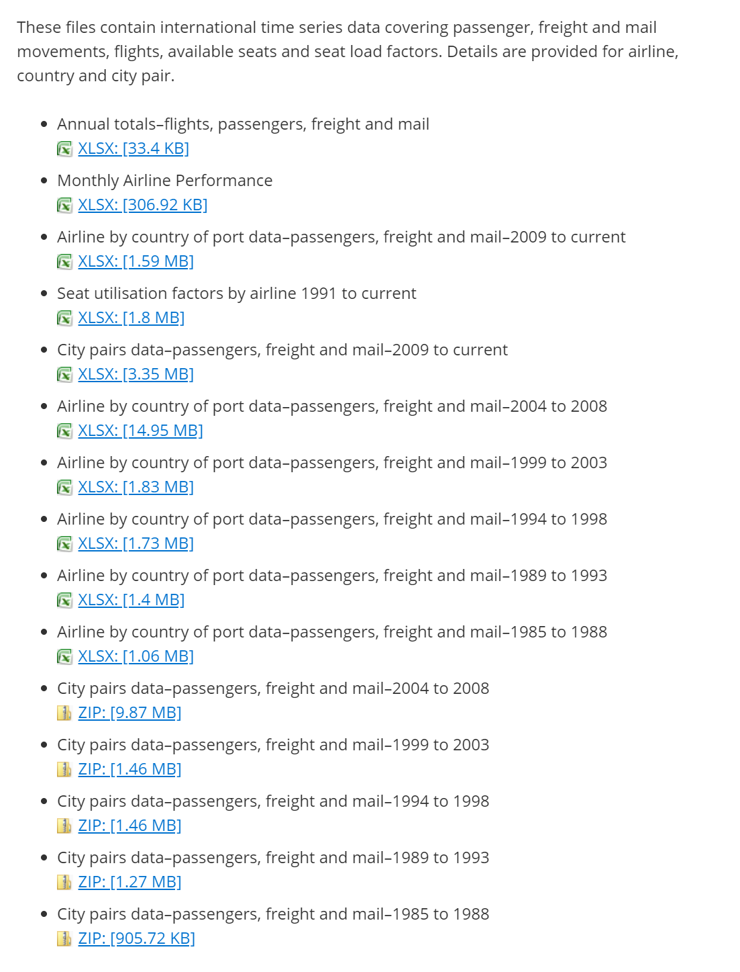
International
City pairs datasets are the most interesting

Slide 7
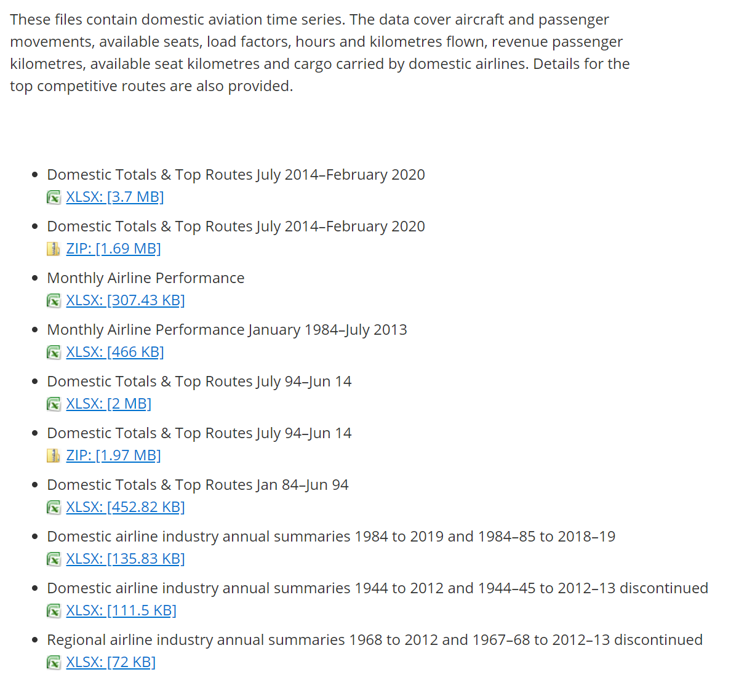
Domestic
Domestic Top Routes is similar to the International City Pairs data

Slide 8
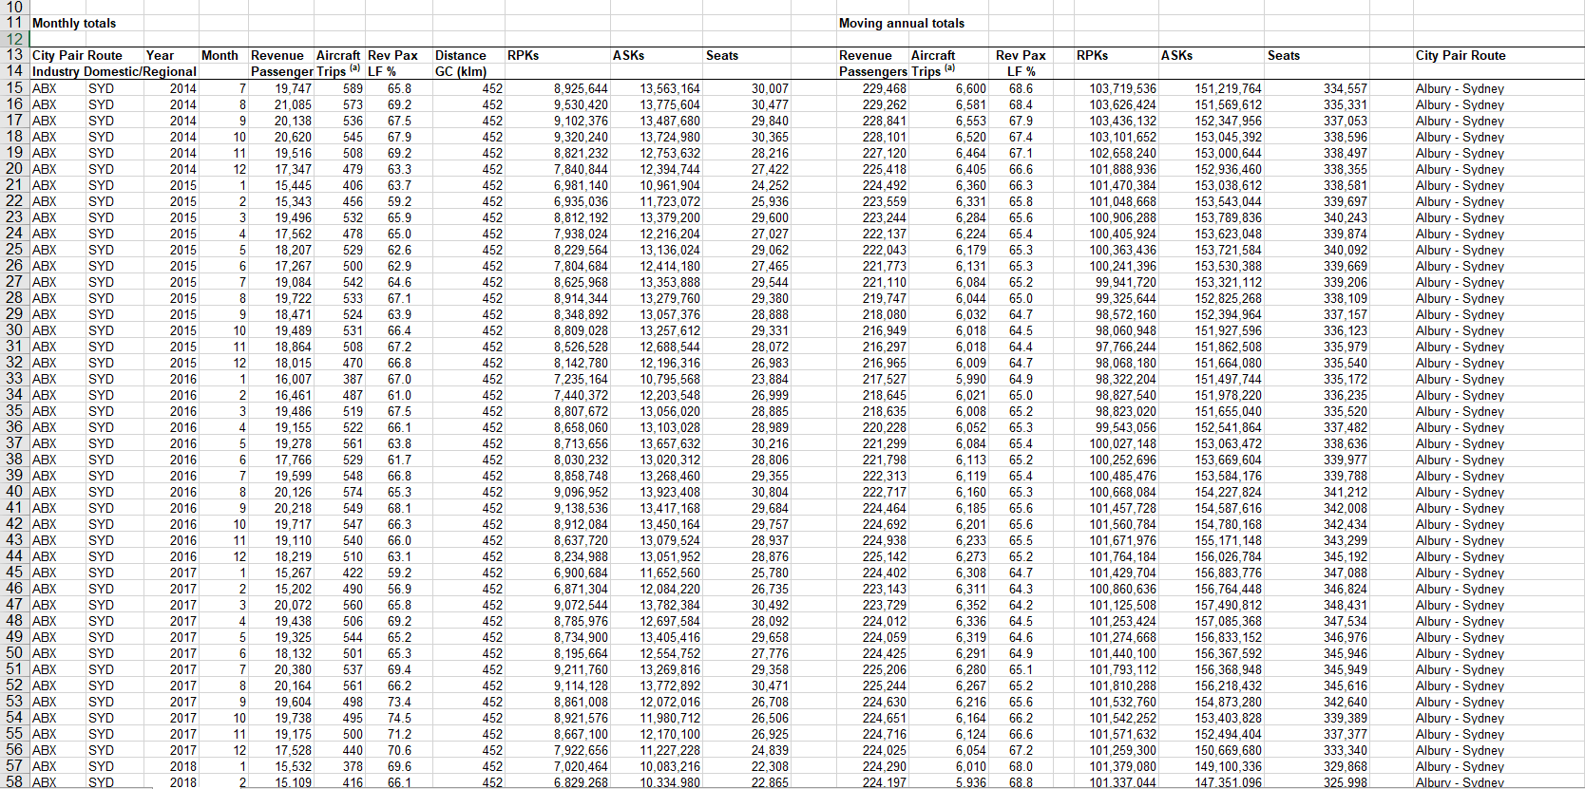

Slide 9
Processing

Slide 10

pandas used to combine excel spreadsheets into a data frame
Remove unnecessary columns while importing

Slide 11

xarray provides fantastic n-dimensional arrays
Pandas data is then converted to an xarray structure – simplifying working with multidimensional data

